Slide 1
Collaborative Lifecycle Management
TATA TECHNOLOGIES

Slide 2
What is Collaborative Lifecycle Management?
Collaborative Lifecycle Management coordinates people, processes, and information in iterative software and systems delivery.

Slide 3
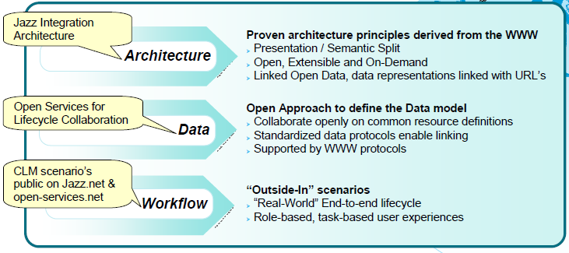
Collaborative Lifecycle Management, Architectural Aspects

Slide 4
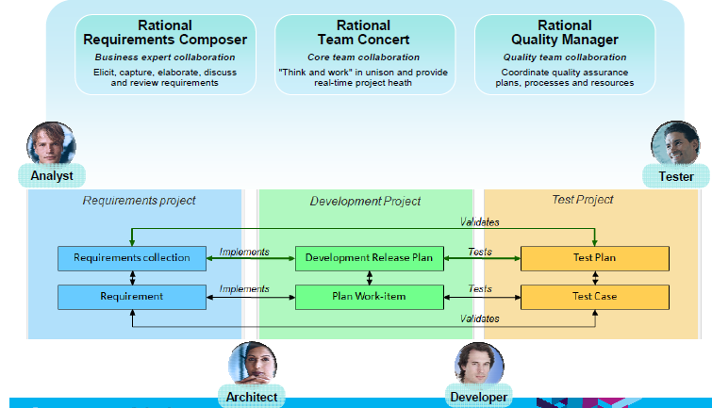
Collaborative Lifecycle Management, Illustration in Practice

Slide 5
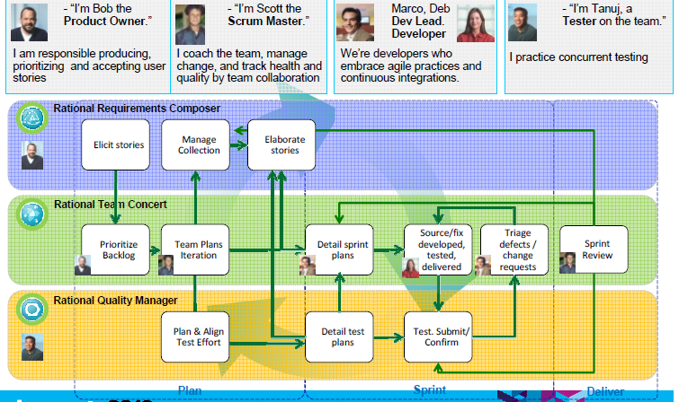
Collaborative Lifecycle Management, Illustration in Practice

Slide 6
Requirements Composer users can:
Create/Link Requirement Collections to Quality Manager Test Plans
Create/Link Requirements to Quality Manager Test Cases
Create/Link Requirements to Team Concert Plan Work Items
CLM Mash-up Dashboards containing view lets from Team Concert, from Quality Manager,

Slide 7
Team Concert users can:
Create/Link Plan Work Items to Requirements Composer Requirements
Create/Link Plan Work Items to Quality Manager Test Cases
CLM Queries: Defects blocking Test
CLM Mash-up Dashboards containing viewlets from Requirements Composer, Quality Manager, ...

Slide 8
Quality Managers users can:
Create/Link Test Plans to Requirements Composer Requirement Collections
Create/Link Test Cases to Requirements Composer Requirements
Create/Link Test Cases to Team Concert Plan Work Items
Create/Link to Team Concert Defects for Failed Test Execution Results
CLM Queries: Tests blocked by Defects
CLM Mash-up Dashboards containing view lets from Requirements Composer, from Team Concert, ...

Slide 9
Thank You.

